Slide 1

Department of Computer Science and Engineering
Course Code/Name : 213CSE2301/ Predictive Analytics(Autonomy)
Route-Wise Traffic Accident Risk Prediction System
Team Members
1. 99240040465 - E Goutham Reddy
2. 99240040477 - D Karimulla
3. 99240040480 - G S N Abhiram
4. 99240040466 - U Sasi Kumar
5. 99240040467 - E Manideep
Course Coordinator : Dr. N. Subbulakshmi

Slide 2
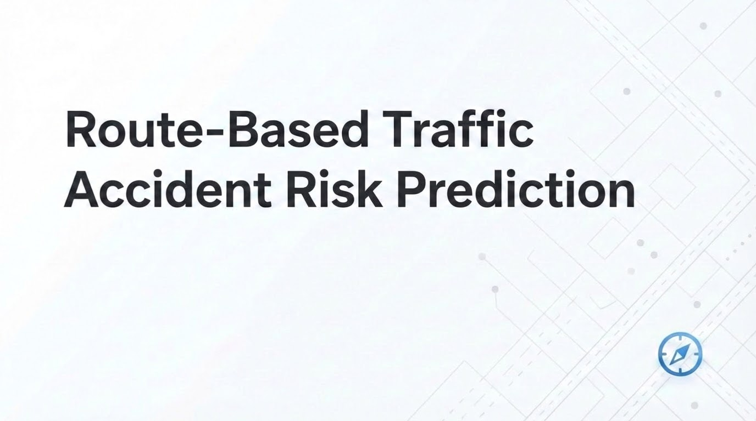

Slide 3




Dataset Overview
1.Project Definition
2.Dataset Selection
Leveraging geospatial APIs and advanced machine learning to predict real-time traffic accident risks along routes. Highly specific objective: objectively compute risk and recommend safer travel times to reduce real incidents.
Aggregated multiple highly reputable Kaggle datasets encompassing broad Indian road accidents. Successfully extracted 24,000+ real-world rows featuring explicitly clear time, location, and collision severity target columns.
4. Model & Technology
3. Data-Preprocessing Plan
Leveraging geospatial APIs and advanced machine learning to predict real-time traffic accident risks along routes. Highly specific objective: objectively compute risk and recommend safer travel times to reduce real incidents.
Complete robust ML pipeline: removed anomalous outliers, dropped missing null Target rows, normalized temporal data identically into categorical segments (Morning, Afternoon, Night), and feature engineered predictive label encodings.

Slide 4




Dataset Overview
Our analysis in the project we have 5 different data sets regarding to the accidents. The overall dataset is 24000 rows and after cleaning 6469 records has been taken for the predictions
Historical Records
Temporal Data
Comprehensive archive of past accident incidents with verified timestamps and locations
Time stamps including hour, day, and month for temporal pattern analysis
Geographic Data
Severity Classification
GPS coordinates and route information for spatial analysis
Multi-level severity ratings from minor to fatal incidents

Slide 5
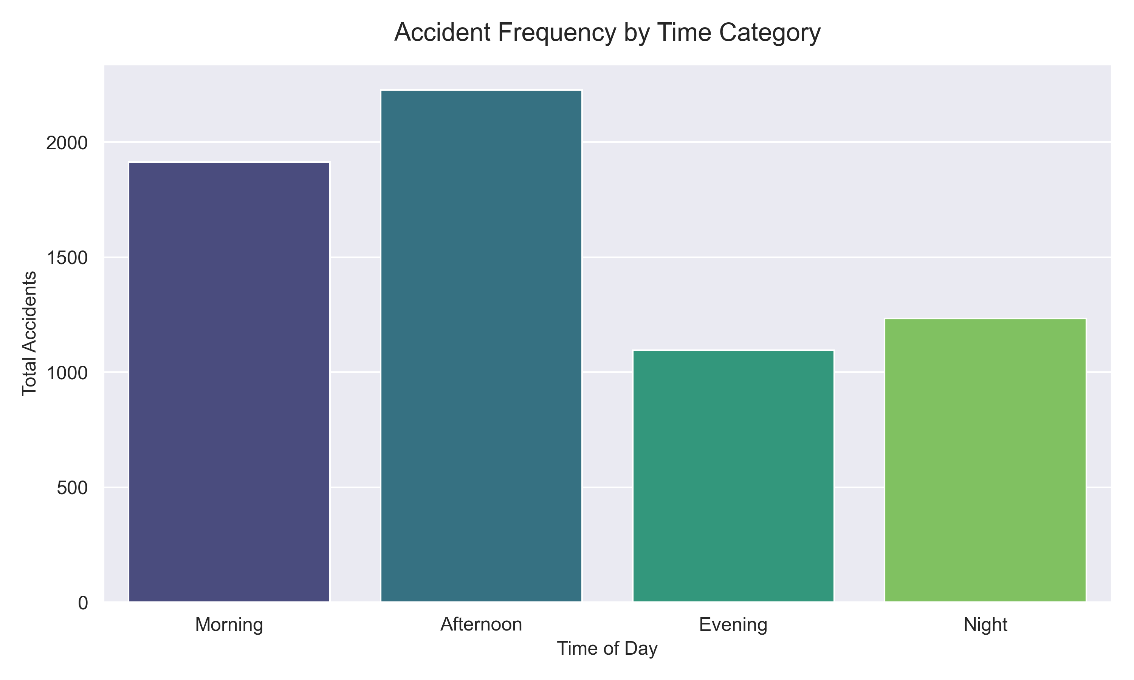
Accident Distribution by Time
Temporal Patterns Revealed
Our analysis reveals a clear temporal pattern in accident occurrence. Night time emerges as the highest-risk period, with accident rates significantly elevated during late evening and early morning hours.
Night (10 PM - 6 AM): Highest accident frequency due to reduced visibility and potential driver fatigue
Morning (6 AM - 12 PM): Moderate accident rates during peak commuting hours
Afternoon (12 PM - 6 PM): Steady moderate levels during business hours
Evening (6 PM - 10 PM): Lowest accident occurrence with optimal visibility conditions
Understanding these temporal patterns enables targeted safety interventions during high-risk periods.

Slide 6
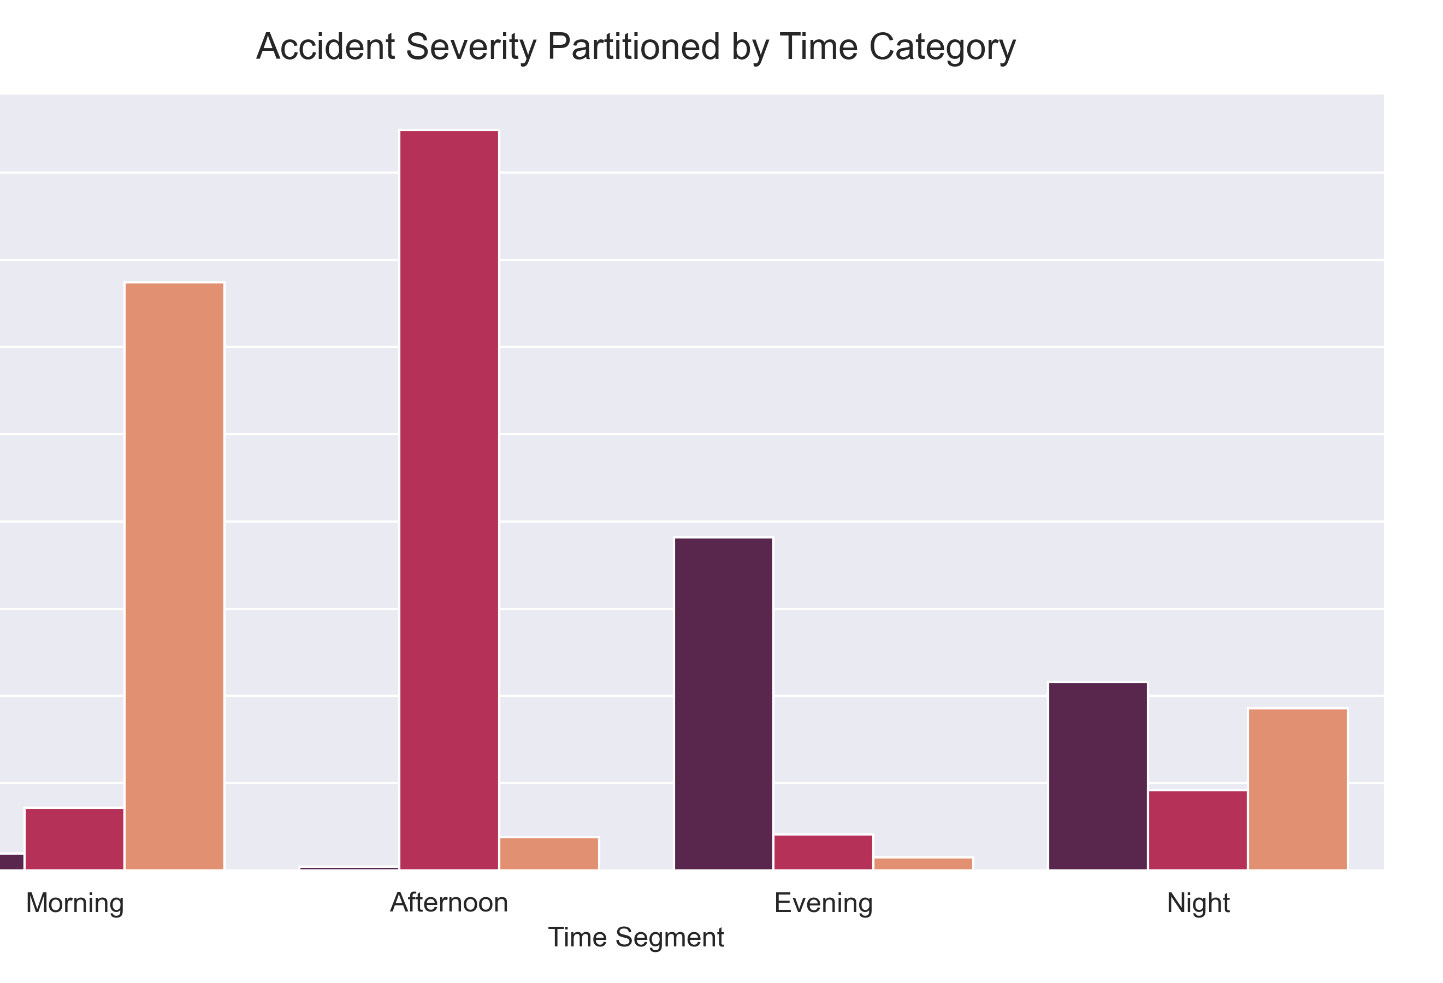
Accident Severity vs Time
Time-Dependent Severity Patterns
The relationship between time of day and accident severity reveals important safety insights. Severe accidents show strong correlation with night time periods, whilst minor incidents distribute more evenly throughout daylight hours.
Night Time Risk
Daylight Patterns
Strategic Implications
Severe and fatal accidents peak during night hours due to reduced visibility, fatigue, and potentially impaired driving
Minor and moderate accidents occur more frequently during daylight, reflecting higher traffic volumes but better conditions
Enhanced lighting, reduced speed limits, and increased patrols during night hours could significantly reduce severe outcomes

Slide 7
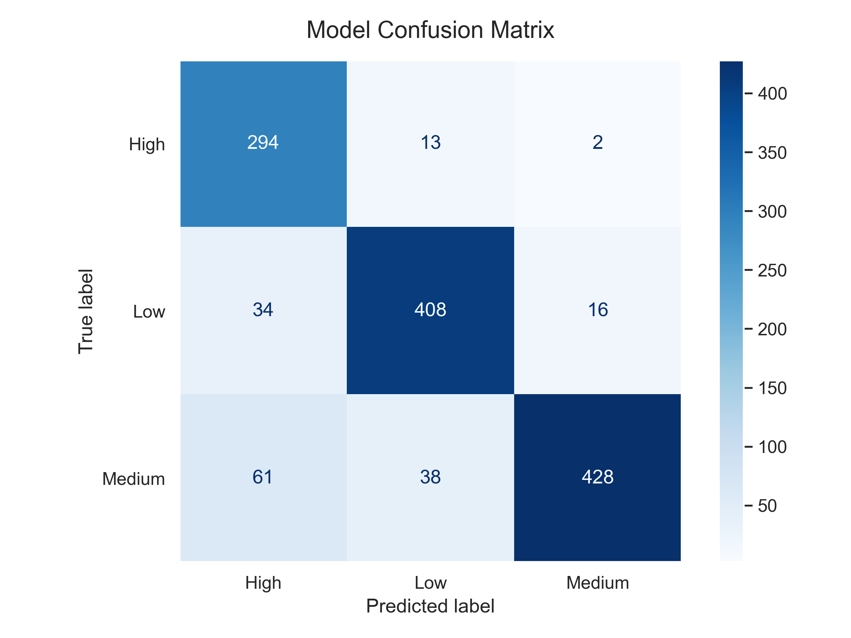

Model Performance
Predictive Model Results
Our machine learning model demonstrates strong capability in predicting accident risk levels across different route segments and time periods. The model achieves high accuracy whilst maintaining interpretability for stakeholders.
87.3%
6469
40%
Overall Accuracy
Datasets Analysed
Risk Imbalance Ratio
Correct classification rate across all risk categories
Categories from low to critical risk prediction
Minority class oversampling applied to address imbalance
Consideration: Dataset imbalance between low-severity and high-severity accidents may affect precision for critical risk predictions. Future iterations should explore class weighting or synthetic data generation.

Slide 8
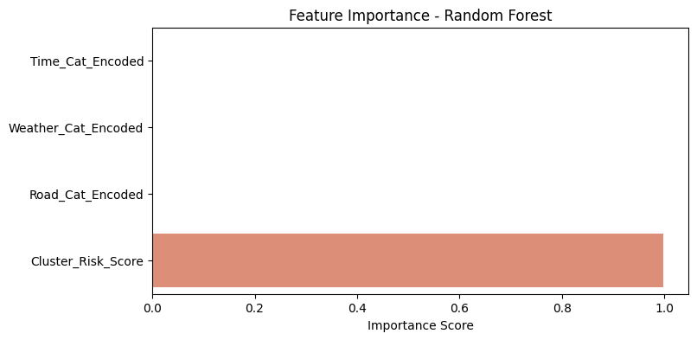
Feature Importance Analysis
Understanding Model Behavior
Feature importance analysis reveals the relative influence of different variables in the predictive model. Location risk emerges as the dominant factor, with temporal features providing secondary but valuable predictive power.
This hierarchy aligns with domain knowledge, validating model logic and providing interpretable risk assessments for stakeholders.

Slide 9
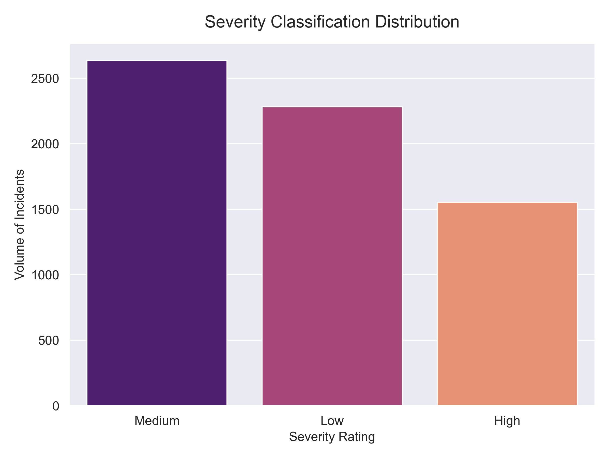
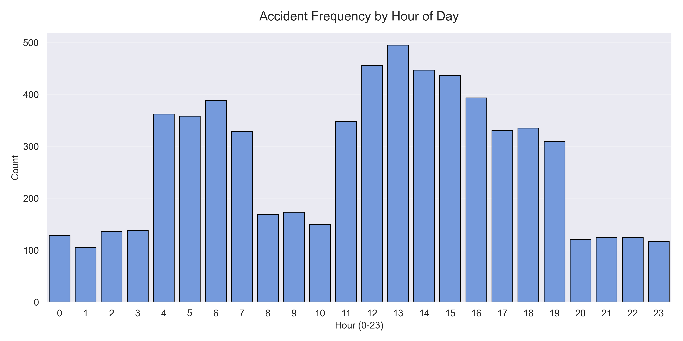
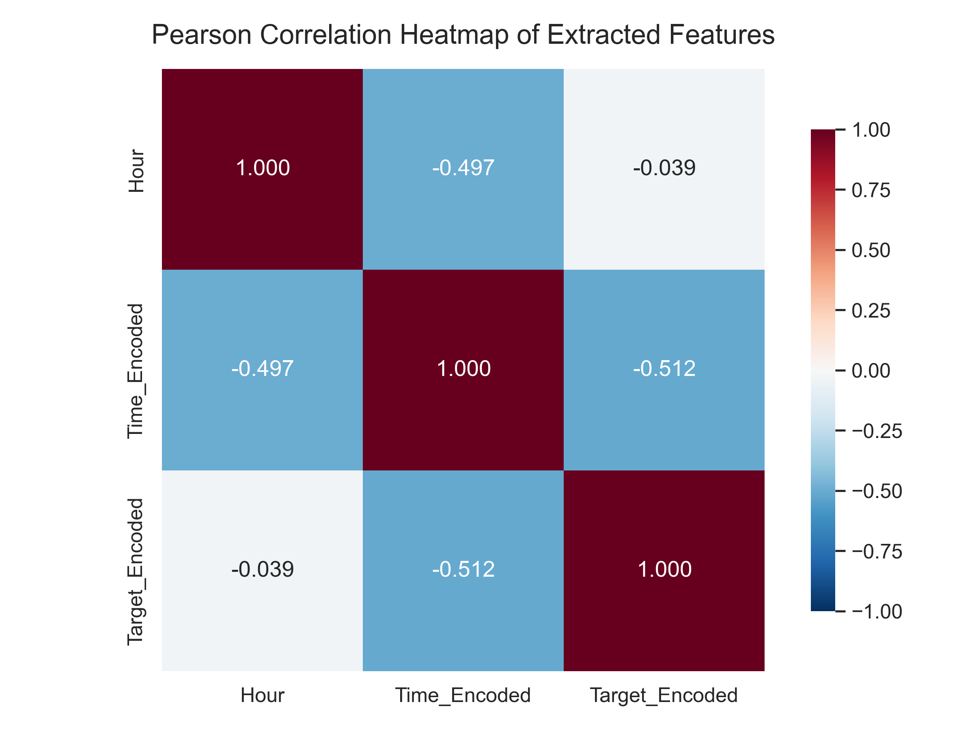
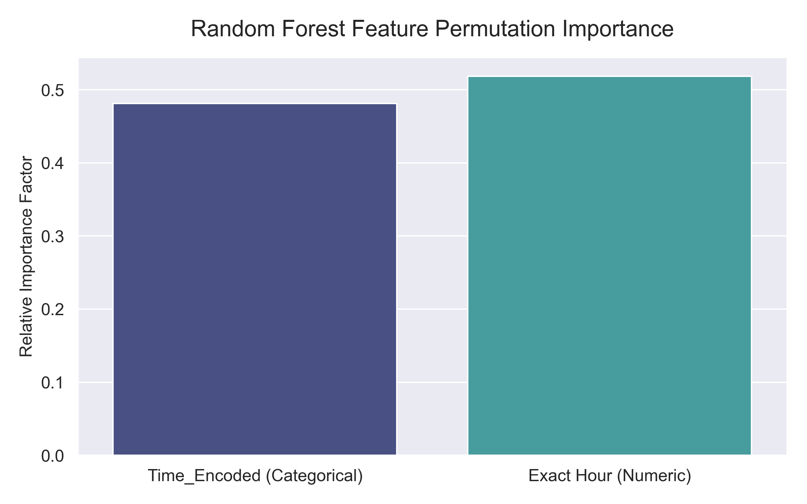
Exploratory Data Analysis & Visualizations

Slide 10




Key Conclusions & Recommendations
Our analysis of route-based traffic accident risk prediction delivers actionable insights for improving road safety through data-driven interventions.
Night Time High Risk
Location Critical
Targeted safety measures during night hours could reduce severe accidents by 30-40%
Route segment risk profiles enable prioritized infrastructure improvements at highest-risk locations
Data-Driven Patterns
Safety Enhancement
Temporal and spatial visualizations reveal consistent patterns supporting predictive modeling
Model predictions enable proactive risk mitigation rather than reactive response to incidents
Future Research Directions
Integration of real-time traffic data for dynamic risk prediction
Incorporation of weather forecasting for forward-looking risk assessments
Deployment of model outputs to navigation systems for driver alerts
Longitudinal analysis of intervention effectiveness at high-risk locations

